Slide 1

RAJALAKSHMI INSTITUTE OF TECHNOLOGY
DEPARTMENT OF COMPUTER SCIENCE AND
ENGINEERING
CS23311 - DATA STRUCTURES

Slide 2
UNIT-1 LINEAR DATA STRUCTURES — LISTS
DEPARTMENT OF COMPUTER SCIENCE AND
ENGINEERING
Abstract Data Types (ADTs) — List ADT — Array-based implementation — Linked list implementation —-Singly linked lists- Circularly linked lists- Doubly-linked lists — Applications of lists –Polynomial ADT — Radix Sort—Multi lists.

Slide 3
Data Structure
DEPARTMENT OF COMPUTER SCIENCE AND
ENGINEERING
A Data Structure is the method of storing and organizing data in the computer memory.
It is the branch of Computer Science that deals with arranging such large datasets in such a manner so that they can be accessed and modified as per the requirements.
In other words, a data structure is a fundamental building block for all critical operations to be performed on the data.

Slide 4
Data Structures examples
DEPARTMENT OF COMPUTER SCIENCE AND
ENGINEERING
The following examples from our day-to-day life will help you understand the concept of data structures.
Our name is a data structure. It comprises First name, Middle Name, and Last name.
The date is a data structure. It includes three types of data viz date (numeric value), month (character or numeric value), and year (numeric value).
The 11-character IFSC code of banks is a data structure.
The first four alphabetic characters in the code indicate the bank name, the fifth character is zero by default, and the last six characters (numeric or alphabetic) represent the branch.

Slide 5
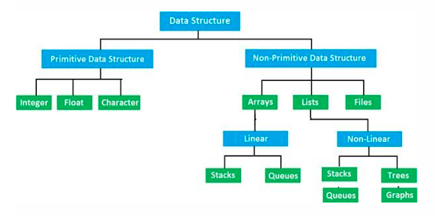
DEPARTMENT OF COMPUTER SCIENCE AND
ENGINEERING

Slide 6
Data Structures are mainly classified into two categories:
DEPARTMENT OF COMPUTER SCIENCE AND
ENGINEERING
Primitive Data Structures:
They store the data of only one type i.e. built-in data types.
Data types like integer, float, character, and booleans come in this category.

Slide 7
Non-Primitive Data Structures:
DEPARTMENT OF COMPUTER SCIENCE AND
ENGINEERING
They can store the data of more than one type i.e. derived data types. Data types like arrays, linked lists, trees, etc. come in this category. Non-Primitive Data Structures are data structures derived from Primitive Data Structures.

Slide 8
What is the Linear data structure
DEPARTMENT OF COMPUTER SCIENCE AND
ENGINEERING
A linear data structure is a structure in which the elements are stored sequentially, and the elements are connected to the previous and the next element.
As the elements are stored sequentially, so they can be traversed or accessed in a single run.
Implementation of linear data structures is easier as the elements are
sequentially organized in memory.
The types of linear data structures are Array, Queue, Stack, Linked List.

Slide 9
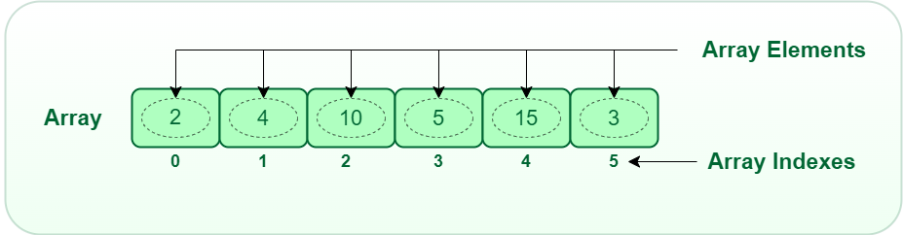
Array:
DEPARTMENT OF COMPUTER SCIENCE AND
ENGINEERING
An array consists of data elements of a same data type.
For example, if we want to store the roll numbers of 10 students, so instead of
creating 10 integer type variables, we will create an array having size 10.
Each element can be accessed directly using its index, making arrays efficient for random access operations.

Slide 10
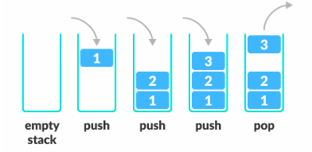
STACK
DEPARTMENT OF COMPUTER SCIENCE AND
ENGINEERING
It is linear data structure that uses the LIFO (Last In-First Out) rule in which the data
added last will be removed first.
The addition of data element in a stack is known as a push operation, and the
deletion of data element form the list is known as pop operation.

Slide 11
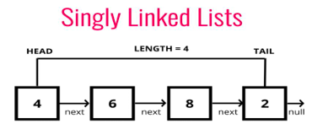
Linked list:
DEPARTMENT OF COMPUTER SCIENCE AND
ENGINEERING
It is a collection of nodes that are made up of two parts, i.e., data element and reference to the next node in the sequence.

Slide 12
What is a Non-linear data structure?
DEPARTMENT OF COMPUTER SCIENCE AND
ENGINEERING
A non-linear data structure is also another type of data structure in which the data elements are not arranged in a contiguous manner.
As the arrangement is non-sequential, so the data elements cannot be traversed or accessed in a single run
In the case of linear data structure, element is connected to two elements (previous and the next element)

Slide 13
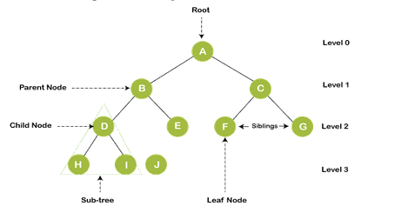
DEPARTMENT OF COMPUTER SCIENCE AND
ENGINEERING
Trees and Graphs are the types of non-linear data structure.
It is a non-linear data structure that consists of various linked nodes.
It has a hierarchical tree structure that forms a parent-child relationship.

Slide 14
GRAPH
DEPARTMENT OF COMPUTER SCIENCE AND
ENGINEERING
A graph is a non-linear data structure that has a finite number of vertices and edges, and these edges are used to connect the vertices.
The vertices are used to store the data elements, while the edges represent the relationship between the vertices.
A graph is used in various real-world problems like telephone networks, circuit networks, social networks like LinkedIn,
Facebook. In the case of facebook, a single user can be considered as a node, and the connection of a user with others is known as edges.

Slide 15
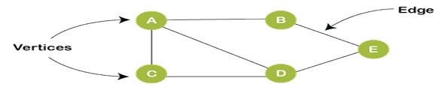
DEPARTMENT OF COMPUTER SCIENCE AND
ENGINEERING

Slide 16
Abstract data type
DEPARTMENT OF COMPUTER SCIENCE AND
ENGINEERING
Definition of ADT | Why abstract?
Stores the Data | Specify the operation on the data structure and leave the implementation details for later
Allows to perform various operations on the data to access it or change it | High level Languages often provide built-in data structures.
But do not show shows how operations are implemented

Slide 17
abstract datatype
DEPARTMENT OF COMPUTER SCIENCE AND
ENGINEERING
The abstract datatype is special kind of datatype, whose behavior is defined by a set of values and set of operations. The keyword “Abstract” is used as we can use these datatypes, we can perform different operations.
But how those operations are working that is totally hidden from the user.
The ADT is made of with primitive datatypes, but operation logics are hidden.

Slide 18



Real-Time Examples of Abstraction
Driving a Car
Using a Smartphone
Turning on a Light
When you turn the key, the car starts. You don't need to know the intricate workings of the engine; you just interact with the interface.
You tap an app icon, and it opens. The complex processes of the operating system and hardware are hidden, providing a seamless user experience.
Flipping a switch illuminates a room. You don't need to understand electrical circuits; the abstraction handles the complexity.

Slide 19
Real time examples?
DEPARTMENT OF COMPUTER SCIENCE AND
ENGINEERING
When we get in car ,we turn the key in the ignition and the car starts.
We shift into gear and drive.
We did not know anything about what actually happens. Data Structures
Phone
How to use the phone
We did not know working principles.
Hide the information from the user did not show anything

Slide 20
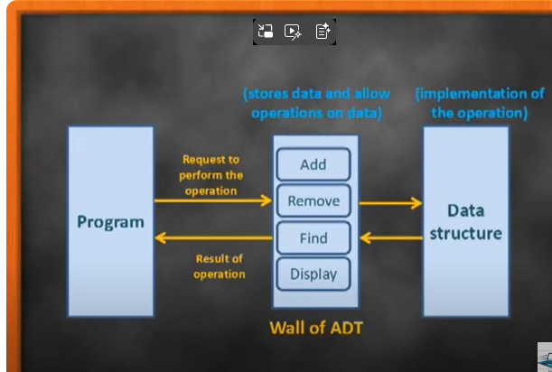
DEPARTMENT OF COMPUTER SCIENCE AND
ENGINEERING

Slide 21
Core Operations in ADT
DEPARTMENT OF COMPUTER SCIENCE AND
ENGINEERING
ADD an item
DELETE an item
FIND/RETRIEVE /ACCESS an item

Slide 22
Why Use ADTs?
DEPARTMENT OF COMPUTER SCIENCE AND
ENGINEERING
Encapsulation: Hides complex implementation details behind a clean interface.
Reusability: Allows different internal implementations (e.g., array or linked list) without changing external usage.
Modularity: Simplifies maintenance and updates by separating logic.
Security: Protects data by preventing direct access, minimizing bugs and unintended changes.

Slide 23
List ADT
DEPARTMENT OF COMPUTER SCIENCE AND
ENGINEERING
List is the data structures that holds collection of items.
List is nothing but a array
List are mutable
Can change the contents after they are created.
List can contain items of different data types, including other list.

Slide 24
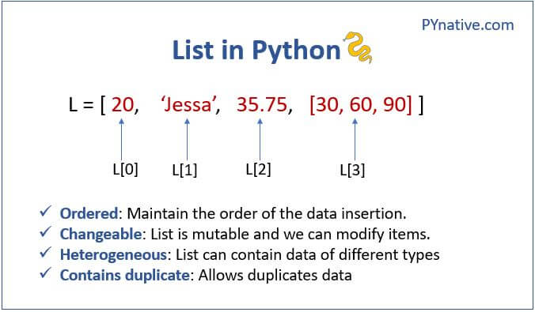
DEPARTMENT OF COMPUTER SCIENCE AND
ENGINEERING

Slide 25
LIST
DEPARTMENT OF COMPUTER SCIENCE AND
ENGINEERING
items = [10,20,30,40,’Python’,True,50.23]
Print(items)
O/P:[10, 20, 30, 40, 'Python', True, 50.23]
items = [10,20,30,40,’Python’,True,50.23,[‘apple’,’Grapes’]
Print(items)
O/P: [10, 20, 30, 40, 'Python', True, 50.23, ['apple', 'Grapes’]]
print(items[7]) O/P APP:GRA
items = [10,20,30,40]
print(items)
O/P [10, 20, 30, 40]
print(items[0])
O/P 10
items = [10,20,30,40]
print(items)
items[0]=15//Mutable
print(items[0])
O/P : 15

Slide 26
DEPARTMENT OF COMPUTER SCIENCE AND
ENGINEERING
items = [10,20,30,40, 'Python',True,50.23, ['apple','Grapes']]
print(items)
print(items[7])
print(len(items))
items.append('Orange')
print(items)
[10, 20, 30, 40, 'Python', True, 50.23, ['apple', 'Grapes'], 'Orange']
items = [10,20,30,40, 'Python',True,50.23, ['apple','Grapes']]
print(items)
print(items[7])
print(len(items))//built in fun
O/P:8

Slide 27
DEPARTMENT OF COMPUTER SCIENCE AND
ENGINEERING
items = [10,20,30,40, 'Python',True,50.23, ['apple','Grapes']]
print(items)
print(items[7])
print(len(items))
items.append('Orange')
print(items)
items.remove(30)
print(items)
O/P
[10, 20, 40, 'Python', True, 50.23, ['apple', 'Grapes'], 'Orange']

Slide 28
DEPARTMENT OF COMPUTER SCIENCE AND
ENGINEERING
items = [10,20,30,40, 'Python',True,50.23, ['apple','Grapes']]
print(items)
print(items[7])
print(len(items))
items.append('Orange')
print(items)
items.remove(30)
print(items)
items.pop()//Last items removed
print(items)
O/P:
[10, 20, 40, 'Python', True, 50.23, ['apple', 'Grapes’]]
items = [10,20,30,40, 'Python',True,50.23, ['apple','Grapes']]
print(items)
print(items[7])
print(len(items))
items.append('Orange')
print(items)
items.remove(30)
print(items)
items.pop()
print(items)
items.pop(0)/remove 10
print(items)
O/P:
items.clear
print(items)

Slide 29
DEPARTMENT OF COMPUTER SCIENCE AND
ENGINEERING
items = [10,20,40,50]
print(items)
items.reverse()
print(items)
O/P:
[10, 20, 40, 50]
[50, 40, 20, 10]
items = [10,20,40,50]
print(items)
items.reverse()
print(items)
items.sort()
print(items)
O/P: 10,20,40,50

Slide 30
Implementation of List ADT
DEPARTMENT OF COMPUTER SCIENCE AND
ENGINEERING
The LIST ADT can be implemented in two ways
Array Based implementation
Linked List implementation

Slide 31
Array Based implementation
DEPARTMENT OF COMPUTER SCIENCE AND
ENGINEERING
The first node of a linked list is called the Head, and it acts as an access point.
The head pointer points to the first element of the linked list.
The last node is called the Tail, and it marks the end of a linked list by pointing to a NULL value.

Slide 32
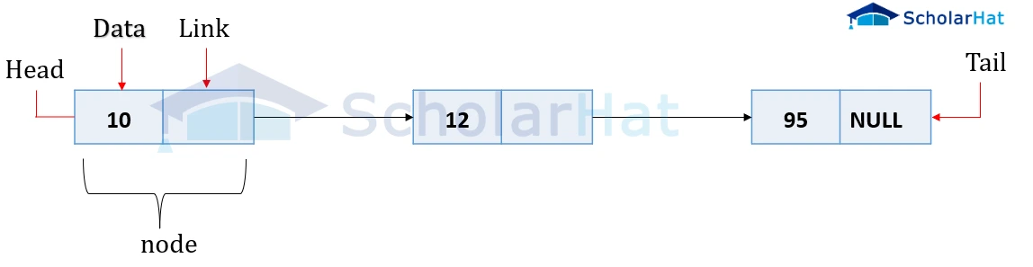
DEPARTMENT OF COMPUTER SCIENCE AND
ENGINEERING

Slide 33
Operations:
DEPARTMENT OF COMPUTER SCIENCE AND
ENGINEERING
insert(): Insert an element at any position in the list.
remove(): Remove the first occurrence of any element from a non-empty list.
removeAt(): Remove the element at a specified location from a non-empty list.
replace(): Replace an element at any position with another element.
size(): Return the number of elements in the list.
isEmpty(): Return true if the list is empty; otherwise, return false.
isFull(): Return true if the list is full, otherwise, return false. Only applicable in fixed-size implementations (e.g., array-based lists)

Slide 34
Import array
DEPARTMENT OF COMPUTER SCIENCE AND
ENGINEERING
import array//1 method array import
//arr=array.array(‘type_code’,[])
arr=array.array('i',[1,2,3,3,5])//(‘type_code’,[])
print(arr)
import array as ar//2 method
arr=ar.array ('i',[1,2,3,3,5])
print(arr)
from array import *//3 method
arr=array ('i',[1,2,3,3,5])
Print(arr)

Slide 35
Insert
DEPARTMENT OF COMPUTER SCIENCE AND
ENGINEERING
from array import *
arr=array('i', [1,2,3,4,5])//array accesing
print(arr[4])
O/P:5
from array import *
arr=array('i', [1,2,3,4,5])//array accesing
print(arr[4])
arr.insert(0,6)
Print(arr)
O/P: array('i', [6, 1, 2, 3, 4, 5])

Slide 36
Delete Operation
DEPARTMENT OF COMPUTER SCIENCE AND
ENGINEERING
from array import *
arr=array('i', [1,2,3,4,5])
arr.pop(0)
print(arr)
O/P
array('i', [2, 3, 4, 5])

Slide 37
Search Operation
DEPARTMENT OF COMPUTER SCIENCE AND
ENGINEERING
from array import *
arr=array('i', [1,2,3,4,5])
a=2
for i in arr:
If i==2:
print(“true”)
Break
O/P”True

Slide 38
Searching
DEPARTMENT OF COMPUTER SCIENCE AND
ENGINEERING
from array import *
arr=array('i', [1,2,3,4,5])
a=5
for i in range(0 ,len(arr)):
if arr[i]==a
print(i)
break
O/P:4

Slide 39
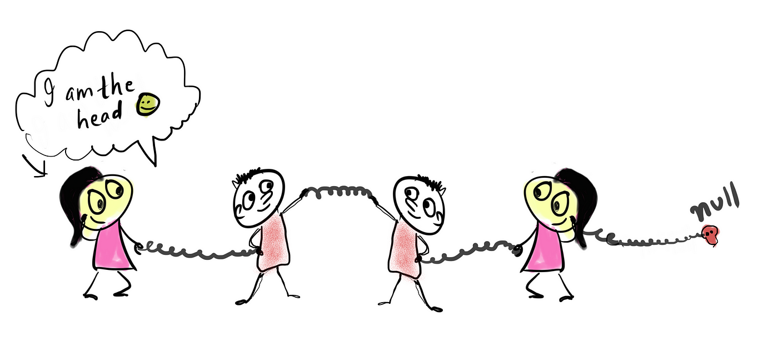
Linked List
DEPARTMENT OF COMPUTER SCIENCE AND
ENGINEERING
Linked List is a very commonly used linear data structure which consists of group of nodes in a sequence.

Slide 40

Linked List
DEPARTMENT OF COMPUTER SCIENCE AND
ENGINEERING
Multiple list linked together
Each node holds its own data and the address of the next node hence forming a chain like structure.
Linked Lists are used to create trees and graphs.

Slide 41
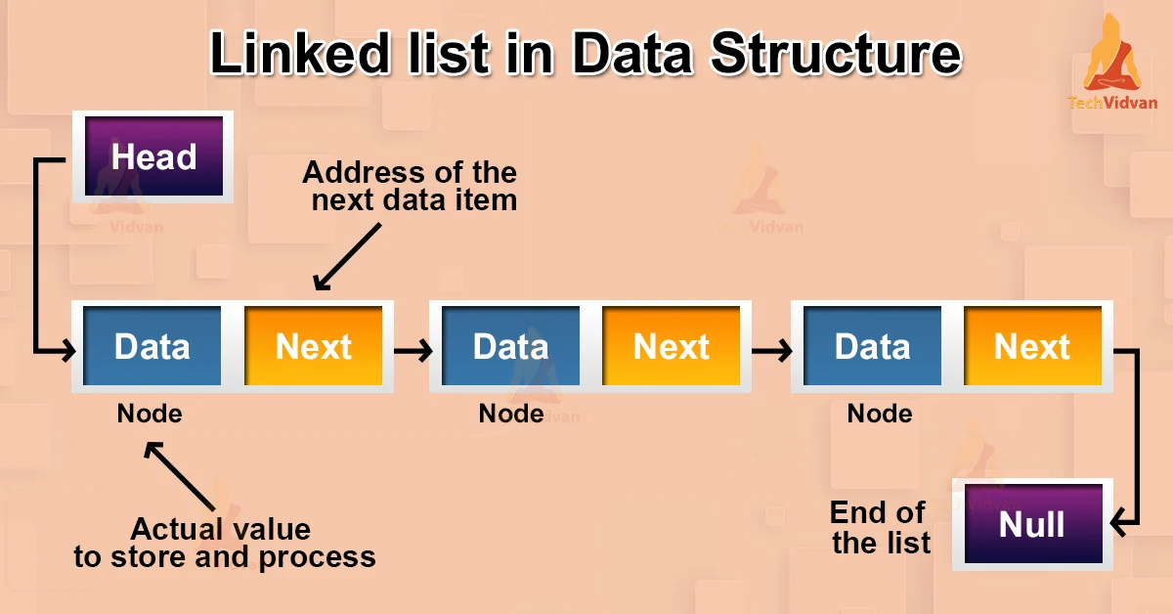
DEPARTMENT OF COMPUTER SCIENCE AND
ENGINEERING

Slide 42
Basic Operations in Linked List
DEPARTMENT OF COMPUTER SCIENCE AND
ENGINEERING
Insertion − Adds an element at the beginning of the list.
Deletion − Deletes an element at the beginning of the list.
Display − Displays the complete list.
Search − Searches an element using the given key.
Delete − Deletes an element using the given key.

Slide 43
Types of Linked List
DEPARTMENT OF COMPUTER SCIENCE AND
ENGINEERING
Singly Linked Lists
Doubly Linked Lists
Circular Linked Lists

Slide 44

Singly Linked Lists
DEPARTMENT OF COMPUTER SCIENCE AND
ENGINEERING
Singly linked lists contain two "buckets" in one node; one bucket holds the data and the other bucket holds the address of the next node of the list. Traversals can be done in one direction only as there is only a single link between two nodes of the same list.

Slide 45
Doubly Linked Lists
DEPARTMENT OF COMPUTER SCIENCE AND
ENGINEERING
Doubly Linked Lists contain three "buckets" in one node; one bucket holds the data and the other buckets hold the addresses of the previous and next nodes in the list. The list is traversed twice as the nodes in the list are connected to each other from both sides.

Slide 46
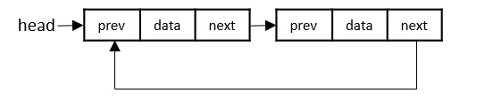
Circular Linked Lists
DEPARTMENT OF COMPUTER SCIENCE AND
ENGINEERING
Circular linked lists can exist in both singly linked list and doubly linked list.
Since the last node and the first node of the circular linked list are connected, the traversal in this linked list will go on forever until it is broken.

Slide 47
DEPARTMENT OF COMPUTER SCIENCE AND
ENGINEERING

Slide 48
DEPARTMENT OF COMPUTER SCIENCE AND
ENGINEERING
Class node:
def__init__(self,data):
self.data=data
self.next=null
Class node:
This create a new class node
def __init__(self, data):
This defines the constructor method.
The __init__ method runs automatically when a new node object is created.
self refers to the current object (the node being created).

Slide 49
data is a parameter used to store the value in this node.
DEPARTMENT OF COMPUTER SCIENCE AND
ENGINEERING
data is a parameter used to store the value in this node.
self.data = data
Assign the values
self.next = None
address

Slide 50
DEPARTMENT OF COMPUTER SCIENCE AND
ENGINEERING
class Node:
def __init__(self, data):
self.data = data
self.next = None
class SingleLinkedList:
def __init__(self):
self.head = None
def display(self):
if self.head is None:
print("Linked list is empty")
else:
temp = self.head
while temp:
print(temp.data, "-->", end=" ")
temp = temp.next
print()

Slide 51
DEPARTMENT OF COMPUTER SCIENCE AND
ENGINEERING
# Creating linked list
l = SingleLinkedList()
n = Node(10)
l.head = n
n1 = Node(20)
l.head.next = n1
# Display linked list
l.display()
O/P: 10 --> 20 -->

Slide 52
Insertion Operation of Linked List
DEPARTMENT OF COMPUTER SCIENCE AND
ENGINEERING
Insertion at Beginning
Nb=Node(data)
Nb.next=self.head
Self.head=nb
5
NULL
5
1100
10
1200
20
NULL

Slide 53

Insert at End
DEPARTMENT OF COMPUTER SCIENCE AND
ENGINEERING
Ne = Node (data)
temp = self.head
While temp.next:
temp=temp.next
temp.next=ne
40
NULL

Slide 54
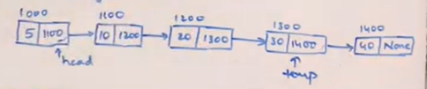
DEPARTMENT OF COMPUTER SCIENCE AND
ENGINEERING

Slide 55

Insert at position
DEPARTMENT OF COMPUTER SCIENCE AND
ENGINEERING
np = node(data) pos(3)
temp = self.head
for i in range(pos-1)
temp = temp.next
np.data = data
np.next = temp.next
temp.next = np
50
null

Slide 56
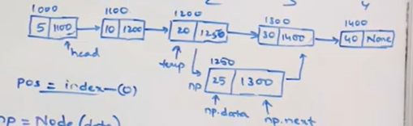
DEPARTMENT OF COMPUTER SCIENCE AND
ENGINEERING

Slide 57
Circular Linked Lists
DEPARTMENT OF COMPUTER SCIENCE AND
ENGINEERING
Similar to singly linked list
Last node will have address of first node
Collection of nodes connected in circular fashion.

Slide 58
DEPARTMENT OF COMPUTER SCIENCE AND
ENGINEERING

Slide 59
DEPARTMENT OF COMPUTER SCIENCE AND
ENGINEERING
class Node:
def __init__(self, data):
self.data = data
self.next = None
class CLL:
def __init__(self):
self.head = None
self.tail = None
def display(self):
if self.head is None:
print("Empty circular list")
else:
temp = self.head
print(temp.data, end=" -> ")
while temp.next != self.head:
temp = temp.next
print(temp.data, end=" -> ")
print("(Back to Head)")

Slide 60
DEPARTMENT OF COMPUTER SCIENCE AND
ENGINEERING
# Create a circular linked list
L = CLL()
# First Node
n1 = Node(10)
L.head = n1
L.tail = n1
L.tail.next = L.head
print("After First Node")
L.display()
# Second Node
n2 = Node(20)
L.tail.next = n2
L.tail = n2
L.tail.next = L.head
print("After Second Node")
L.display()
# Third Node
n3 = Node(30)
L.tail.next = n3
L.tail = n3
L.tail.next = L.head
print("After Third Node")
L.display()

Slide 61
DEPARTMENT OF COMPUTER SCIENCE AND
ENGINEERING
Output:
After First Node
10 -> (Back to Head)
After Second Node
10 -> 20 -> (Back to Head)
After Third Node
10 -> 20 -> 30 -> (Back to Head)

Slide 62

Doubly Linked List
DEPARTMENT OF COMPUTER SCIENCE AND
ENGINEERING
Each node has two pointers:(prev & next ) or (head & tail)
Every node in a doubly linked list has-
Data
Address of the next node
Address of the previous node
First or head node’s prev is null
Last or tail node’s next is null

Slide 63
DEPARTMENT OF COMPUTER SCIENCE AND
ENGINEERING

Slide 64
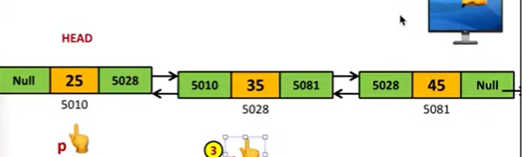
Insert at beginning
DEPARTMENT OF COMPUTER SCIENCE AND
ENGINEERING
n=node(5)
temp = self.head
temp.prev=n
n.next=temp
Self.head=n
1
N
5
N

Slide 65
Insert at End
DEPARTMENT OF COMPUTER SCIENCE AND
ENGINEERING
n=node(50)
temp=self.head
While temp.next is not null:
temp=temp next
temp.next=n
n.prev=temp
N
N
5
N

Slide 66
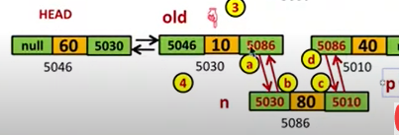
Insert at position
DEPARTMENT OF COMPUTER SCIENCE AND
ENGINEERING
N= nod(25)
temp = self.head
for i in range (1,pos-1)
temp = temp.next
n.prev = temp
n.next=temp.next
temp.next.prev=n
temp.next=n

Slide 67
Circular Linked List
DEPARTMENT OF COMPUTER SCIENCE AND
ENGINEERING
Circular linked list is a data structure where the last node connects back to the first, forming a loop.
A circular linked list is a special type of linked list where all the nodes are connected to form a circle.
This structure allows for continuous traversal without any interruptions.

Slide 68
DEPARTMENT OF COMPUTER SCIENCE AND
ENGINEERING

Slide 69
Types of Circular Linked Lists
DEPARTMENT OF COMPUTER SCIENCE AND
ENGINEERING
Circular Singly Linked List
Circular Doubly Linked List:
Circular Singly Linked List
Circular Singly Linked List, each node has just one pointer called the "next" pointer. The next pointer of the last node points back to the first node and this results in forming a circle.

Slide 70
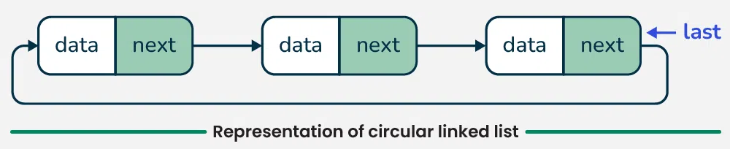
DEPARTMENT OF COMPUTER SCIENCE AND
ENGINEERING

Slide 71
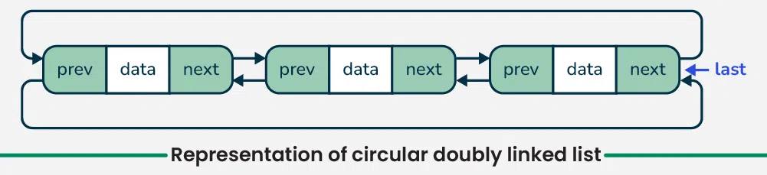
Circular Doubly Linked List
DEPARTMENT OF COMPUTER SCIENCE AND
ENGINEERING
Circular doubly linked list, each node has two pointers prev and next, similar to doubly linked list.
The prev pointer points to the previous node and the next points to the next node.

Slide 72
DEPARTMENT OF COMPUTER SCIENCE AND
ENGINEERING

Slide 73
Applications of list
DEPARTMENT OF COMPUTER SCIENCE AND
ENGINEERING
Image viewer - Previous and next images are linked and can be accessed by the next and previous buttons.
Previous and next page in a web browser - We can access the previous and next URL searched in a web browser by pressing the back and next buttons since they are linked as a linked list.

Slide 74
DEPARTMENT OF COMPUTER SCIENCE AND
ENGINEERING
Music Player:Songs in the music player are linked to the previous and next songs.
GPS navigation systems:Linked lists can be used to store and manage a list of locations and routes.
Robotics- Linked lists can be used to implement control systems for robots, allowing them to navigate and interact with their environment.

Slide 75
DEPARTMENT OF COMPUTER SCIENCE AND
ENGINEERING
Task Scheduling: Os use linked lists to manage task scheduling, where each process waiting to be executed is represented as a node in the list.
Speech Recognition- Speech recognition software uses linked lists to represent the possible phonetic pronunciations of a word

Slide 76
DEPARTMENT OF COMPUTER SCIENCE AND
ENGINEERING
Undo/Redo Functionality: Many software applications implement undo/redo functionality using linked lists.
where each action that can be undone is represented as a node in a doubly linked list.

Slide 77
POLYNOMIAL ADT
DEPARTMENT OF COMPUTER SCIENCE AND
ENGINEERING
A Polynomial ADT (Abstract Data Type) is a data structure that represents a polynomial and provides a set of operations to perform on it.
Node of Polynomial
Example:
3x² + 5x +7
Coefficient
Exponent
Next

Slide 78


Consider the following two Polynomials
DEPARTMENT OF COMPUTER SCIENCE AND
ENGINEERING
Polynomial 1: 3x³ + 4x² + 2x + 5
Polynomial 2: 5x³ + 2x² + 3
Polynomial Linked List 1
Polynomial Linked List 2
5x³+ 2x² + 0x¹ +3

Slide 79
DEPARTMENT OF COMPUTER SCIENCE AND
ENGINEERING
Steps to Add Polynomials
1.Initial Pointer
Ptr1 points to (3,3) in polynomial 1
Ptr2 points to (5,3) in polynomial 2
2.Compare Exponent
Both exponents are equal
Add the coefficients: 3+5=8
Results: 8x³
3.Move to the next terms
Ptr 1 points to (4,2)
Ptr 2 points to (2,2)
Both exponents are equal
Add the coefficients: 4+2=6
Results: 8x³ + 6x²
4.Move to the next terms
Ptr 1 points to (2,1)
Ptr 2 points to null
Both exponents are equal
Results: 8x³ + 6x² + 2x
5.Move to the next terms
Ptr 1 points to (5,0)
Ptr 2 points to (3,0)
Both exponents are equal
Results: 8x³ + 6x² + 2x + 8

Slide 80
DEPARTMENT OF COMPUTER SCIENCE AND
ENGINEERING
PSEUDOCODE
Function addpolynomials(poly1,poly2);
Set ptr1 = poly1.head
Set ptr2 = poly2.head
While ptr1 is not null AND ptr2 is not null;
If ptr1.exponent == ptr2.exponnet;
Sum = ptr1.coefficient + ptr2.coefficient
If sum !=0;
Append (sum,ptr1.exponnet) to result
Move ptr1 and ptr2 to the next nodes
Else
if ptr1.exponnet > ptr2.exponent;
Append (ptr1.coefficient,ptr1.exponent) to result
Move ptr1 to the next node
Else
Append(ptr2.coefficient, ptr2.exponent) to result
Move ptr2 to the next node
While ptr1 is not null;
Append(ptr1. Coefficient,ptr1.exponent ) to result
Move ptr1 to the next node
While ptr2 is not null;
Append(ptr2. Coefficient,ptr2.exponent ) to result
Move ptr to the next node
Return result

Slide 81
Radix Sort
DEPARTMENT OF COMPUTER SCIENCE AND
ENGINEERING
Radix Sort is a linear sorting algorithm that sorts elements by processing them digit by digit.
It is an efficient sorting algorithm for integers or strings with fixed-size keys.
Radix Sort can be performed using different variations,
such as Least Significant Digit (LSD) Radix Sort or Most Significant Digit (MSD) Radix Sort.

Slide 82

DEPARTMENT OF COMPUTER SCIENCE AND
ENGINEERING
Example:
For the given unsorted list of elements, 236, 143, 26, 42, 1, 99, 765, 482, 3, 56,
Step 1
Step 2
Construct a table to store the values based on their indexing

Slide 83
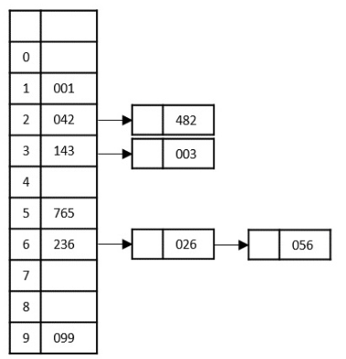
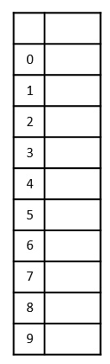
DEPARTMENT OF COMPUTER SCIENCE AND
ENGINEERING
Step 3
Step 2
Step 3

Slide 84
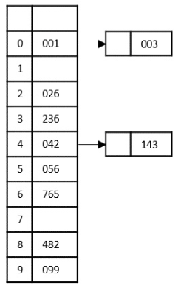
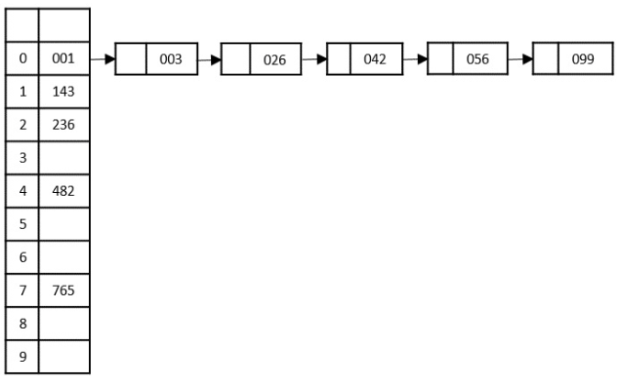

DEPARTMENT OF COMPUTER SCIENCE AND
ENGINEERING
Step 4
Step 5
The final sorted output is

Slide 85
MULTI LIST
DEPARTMENT OF COMPUTER SCIENCE AND
ENGINEERING
A Multilist in data structures is a linked data structure where each node can have multiple pointers (links), not just one "next" pointer like in a regular linked list.
It is a special type of List
It contains two or more pointers to other nodes.
It is used to organize multiple orders of one set of elements.

Slide 86
DEPARTMENT OF COMPUTER SCIENCE AND
ENGINEERING
Properties
It is an integrated list (Single,Double,Circular)
All the nodes are integrated in using links of pointers.
Linked nodes are connected with related data.
Nodes contain pointers from one structure to the other.

